Slide 1


Analyzing Real-Estate Trends with Zestimate Data
Data 607 Final Project Presentation
insights into the Housing Market and Home Prices
Presented by: NFN Tenzin Dakar

Slide 2
Data Source & Project Goal
Datasets:
Sourced from Kaggle’s Zillow https://www.kaggle.com/c/zillow-prize-1/data
Project Goal
Objective:
Understand relationships between home prices and housing characteristics
Examine the impact of economic forces and geographical inequality
Apply learned concepts to generate a thorough analysis

Slide 3
Data Preparation
Libraries Used:
tidyverse, psych, shiny, leaflet, ggplot2, h2o, corrplot, and others
Missing Data:
Examined missing values by column and row
Variables with >20% missing data were removed
Result:
Reduced dataset from 58 to 29 variables

Slide 4
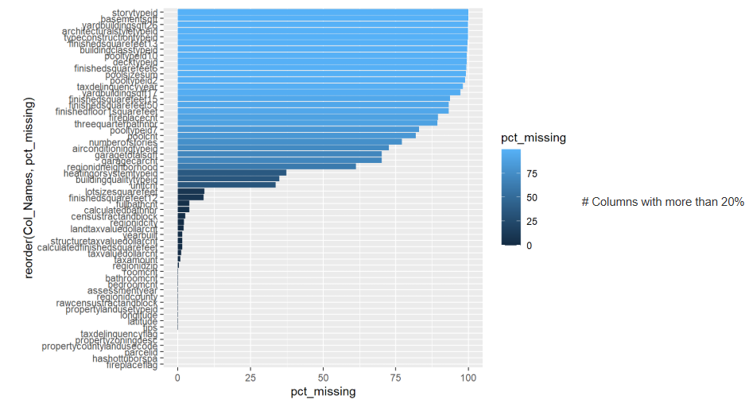
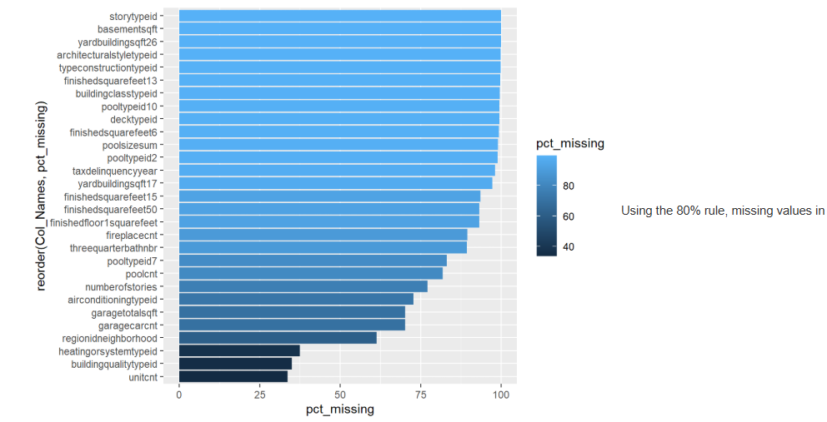
DATA VISUALIzATION

Slide 5
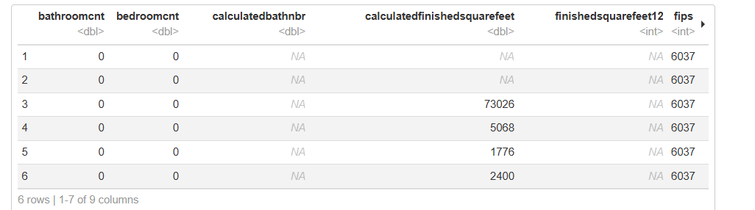
Data ANALYSIS

Slide 6
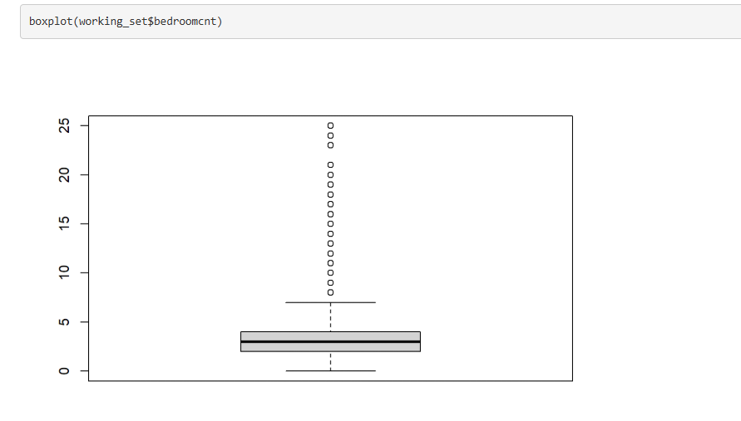
Data ANALYSIS
The boxplot displays the distribution of bedroom counts (bedroomcnt) in the dataset
Median (Central Line): The median bedroom count is around 3, indicating this is the typical value.
Interquartile Range (Box): Most properties have between 2 to 4 bedrooms.
Whiskers: Show the range of typical bedroom counts, extending slightly beyond 5.
Outliers (Dots): There are properties with an unusually high number of bedrooms (e.g., above 10 and up to 25).

Slide 7
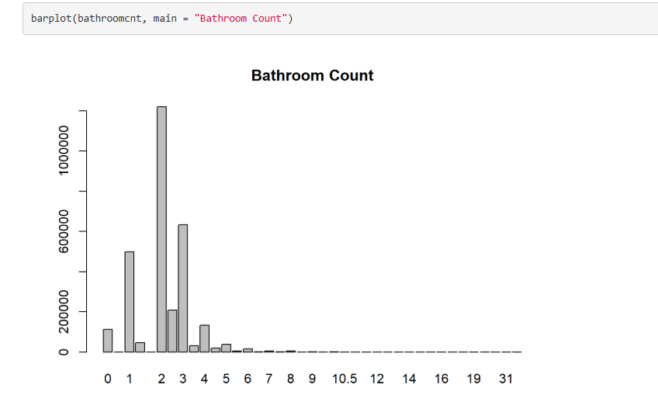
Data ANALYSIS
The bar plot displays the distribution of bathroom counts (bathroomcnt) in the dataset
Most Common Values: Properties with 2 bathrooms are the most frequent, followed by 1 and 3 bathrooms.
Range: The bathroom count ranges from 0 to 31, but higher counts (above 6) are extremely rare.
Skewness: The data is highly skewed toward properties with fewer bathrooms, indicating most homes have between 1 and 3 bathrooms.

Slide 8
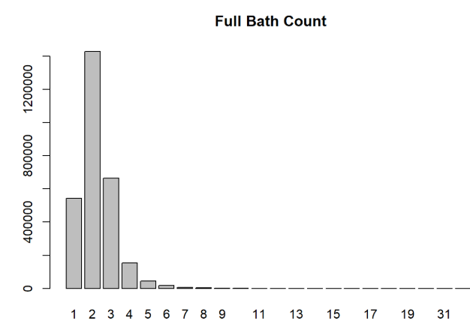
Data ANALYSIS
The two plots provide insights into the distribution of full bathroom counts (fullbathcnt) in the dataset.
Bar Plot: Full Bath Count
Most Common Counts: Properties with 2 full bathrooms dominate, followed by those with 1 and 3 bathrooms.
Range: Counts go up to 31, but values beyond 5 are rare.
Skewness: The data is heavily skewed toward properties with fewer full bathrooms.

Slide 9
Data ANALYSIS
The two plots provide insights into the distribution of full bathroom counts (fullbathcnt) in the dataset.
Bar Plot: Full Bath Count
Most Common Counts: Properties with 2 full bathrooms dominate, followed by those with 1 and 3 bathrooms.
Range: Counts go up to 31, but values beyond 5 are rare.
Skewness: The data is heavily skewed toward properties with fewer full bathrooms.

Slide 10
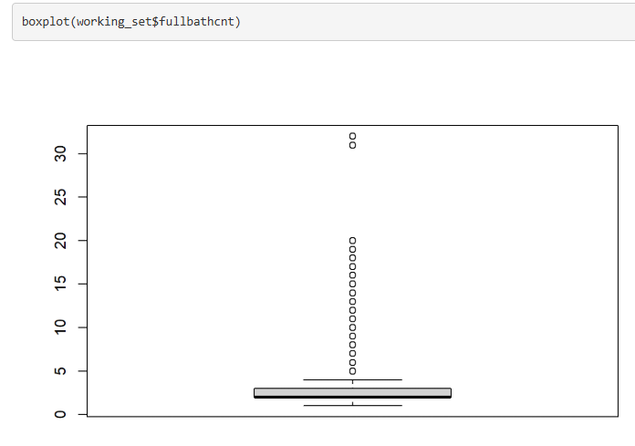
Data ANALYSIS
Box Plot: Full Bath Count
Median and Quartiles: The median is around 2 full bathrooms, with most properties having between 1 and 3 full bathrooms.
Outliers: Extreme values above 6 are visible as outliers, likely luxury properties or outliers in the data.

Slide 11
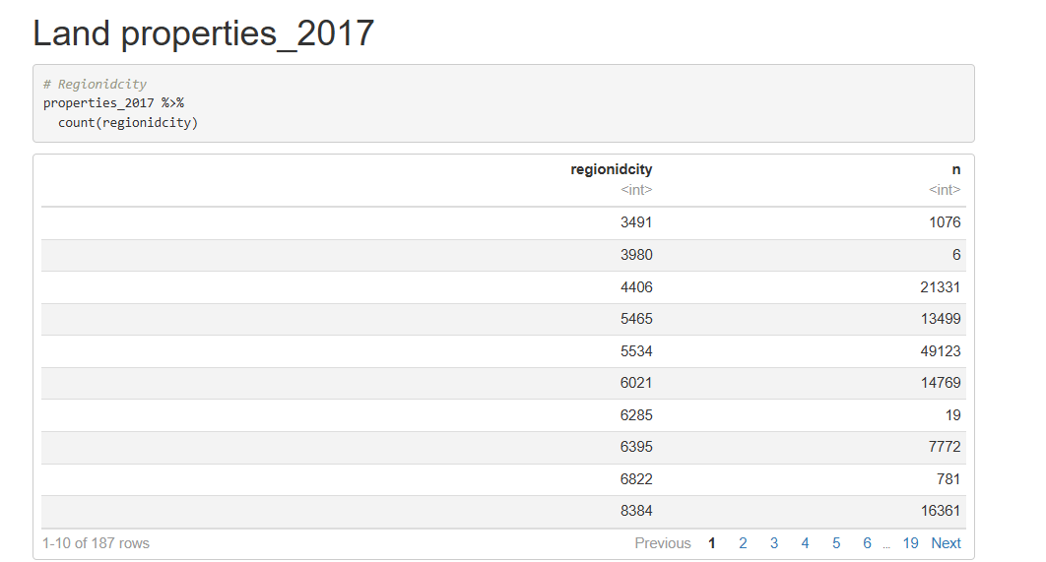
Data ANALYSIS
This table provides a summary of property counts in different regions (regionidcity) from the properties_2017 dataset

Slide 12
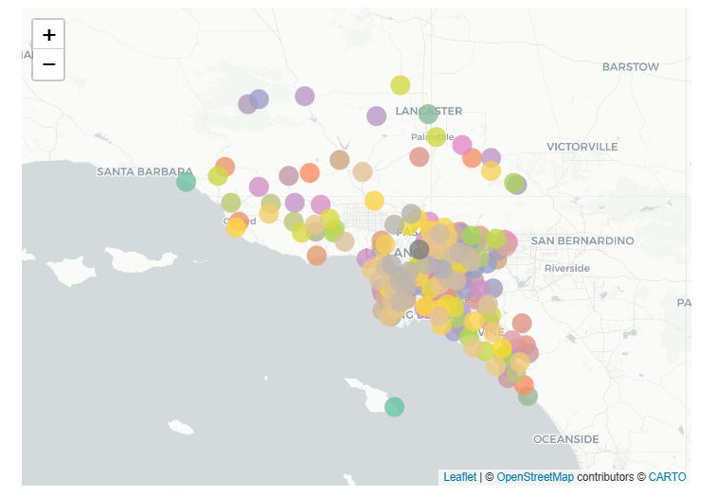
Data ANALYSIS
This map visualization is created using the leaflet package to show the geographical distribution of properties in various regions (regionidcity) from the dataset.
Key Features:
1.Markers
2. Interactive Maps
3.Insights

Slide 13
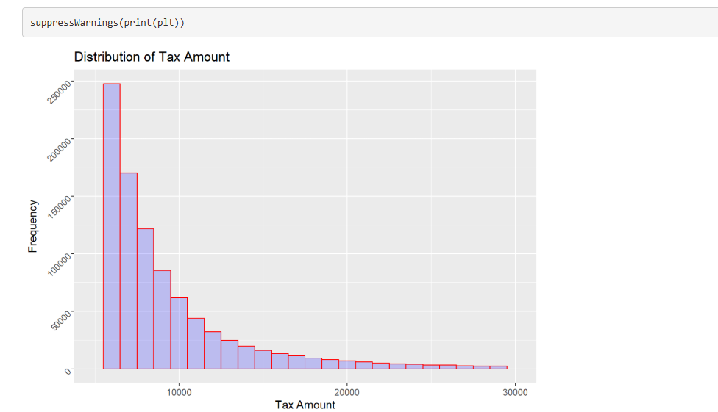
Data ANALYSIS
This histogram visualizes the distribution of property tax amounts in the dataset:
Skewed Distribution.
Frequency.
Range.
This visualization helps identify common tax brackets and highlights disparities in property taxation

Slide 14
Conclusion
In this project, I successfully analyzed housing trends using Zestimate's dataset. The data preparation process involved meticulous cleaning, including removing variables with significant missing values, which refined the dataset from 58 to 29 variables. Through detailed analysis of key features like bedroom and bathroom counts, I uncovered valuable insights about typical housing configurations and extreme outliers.
Data visualizations, including boxplots, bar plots, and an interactive geographic map, highlighted property distributions and spatial trends. The geographic mapping of regions using Leaflet provided deeper understanding of property concentration in urban versus suburban areas, with regions like Los Angeles showing dense clusters.
The histogram of tax amounts revealed a highly skewed distribution, reflecting economic disparities across properties. These findings underscore the importance of features like property size, geographic location, and tax values in influencing housing trends.

Slide 15

Thank You

